Slide 1


ITA0611 - MACHINE LEARNING
Spam Email Classification Using Machine Learning
Guided by:
Jasphin Jeni Sharmila
Presented by : Ajay S (192424078)
Dhiliban M (192421166)
Tharun LV (192524348)

Slide 2
Introduction
Spam emails are unsolicited messages sent in bulk, often containing advertisements, phishing links, malware, or fraudulent content that can compromise user security.
With the rapid growth of digital communication, millions of spam emails are generated every day, making manual filtering inefficient and time-consuming.
Traditional rule-based spam filters rely on predefined keywords and rules, but they struggle to detect new and evolving spam techniques used by cybercriminals.
Machine Learning (ML) enables computers to learn patterns from previously labeled emails and automatically classify new emails as Spam or Ham (Legitimate) with high accuracy.
By analyzing email content, sender information, and textual patterns, ML-based spam filters continuously improve their detection capability, providing better security and a safer email experience for users.

Slide 3
Objectives
Accurately classify emails as Spam or Ham (Legitimate) using Machine Learning techniques to improve email management.
Protect users from cyber threats such as phishing attacks, malware, ransomware, and fraudulent emails by identifying suspicious messages before they reach the inbox.
Reduce false positives and false negatives, ensuring that legitimate emails are delivered correctly while spam emails are effectively filtered.
Improve the efficiency of email communication by minimizing unwanted emails, reducing manual filtering, and enhancing the overall user experience.
Develop a scalable and adaptive spam detection system that continuously learns from new email patterns and evolving spam techniques to maintain high classification accuracy.

Slide 4
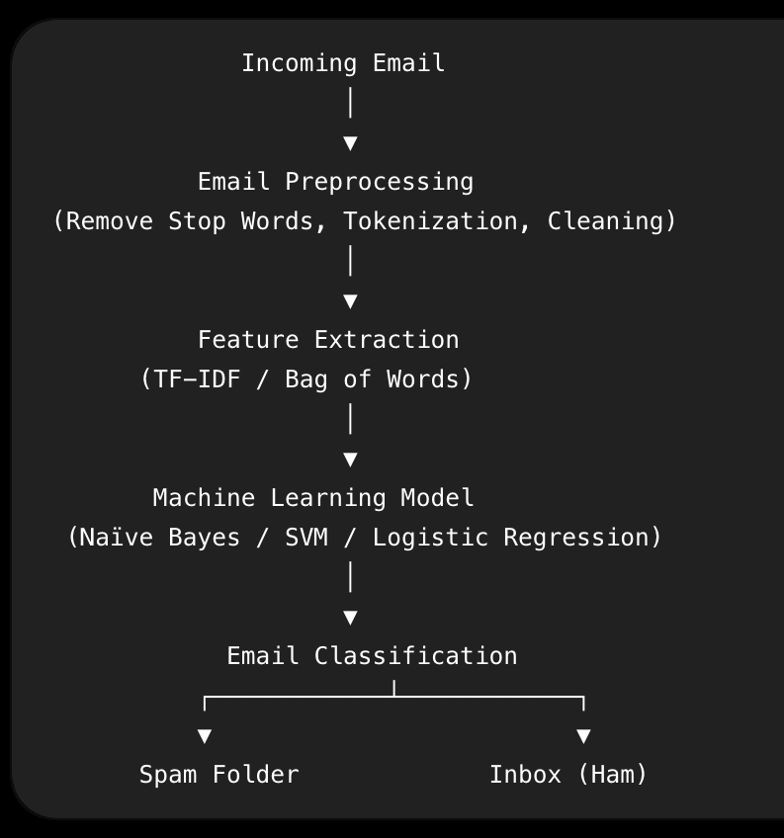
System Architecture
Email is received.
Text is cleaned and processed.
Features are extracted.
ML model predicts the category.
Email is routed to Spam or Inbox.

Slide 5
Core - Technical
Data Collection: A labeled dataset containing both Spam and Ham (Legitimate) emails is collected. These emails serve as the training data for the Machine Learning model to learn different email patterns.
Data Preprocessing: The email text is cleaned by converting it to lowercase, removing punctuation, special characters, stop words, and unnecessary spaces. The text is then tokenized to improve processing efficiency.
Feature Extraction: The cleaned text is transformed into numerical features using techniques such as TF-IDF (Term Frequency–Inverse Document Frequency) or Bag of Words (BoW), enabling the ML model to understand textual information.
Model Training: Machine Learning algorithms such as Naïve Bayes, Logistic Regression, or Support Vector Machine (SVM) are trained using the extracted features to identify patterns that distinguish spam from legitimate emails.
Email Classification: When a new email is received, it undergoes the same preprocessing and feature extraction steps. The trained model then predicts whether the email is Spam or Ham, allowing it to be routed to the appropriate folder.
Performance Evaluation: The model's effectiveness is measured using evaluation metrics such as Accuracy, Precision, Recall, and F1-Score, ensuring reliable spam detection while minimizing incorrect classifications.

Slide 6
Real World Use - Case
Email Services: Gmail, Outlook, and Yahoo Mail automatically filter spam.
Banking: Detect phishing emails that attempt to steal customer credentials. Corporate Organizations: Protect employees from malware and ransomware attacks.
E-commerce Platforms: Prevent fraudulent promotional and scam emails.
Educational Institutions: Filter unwanted emails while ensuring important academic communications reach students.

Slide 7
Conclusion
Machine Learning provides an effective and intelligent approach to spam email detection.
It continuously improves by learning from new email patterns.
Accurate spam filtering enhances cybersecurity and protects sensitive information.
ML-based systems reduce manual effort while improving email reliability.
Future improvements can integrate Deep Learning and Natural Language Processing (NLP) for even higher detection accuracy.

